Slide 1





Example Stories
I want to join more community activities because I know cool people doing it !
I’m not really staying for the activities, but mostly for people.
I’m leaving because my friends left
Links and people are not the number one motivation to me, I’m in this community because of the activity

Slide 2


Challenge P12 Look beyond Individual Engagement : Assess the importance of Link
Link, here used as a word for “quality of relationship between two members”, can often (but not always) be mentioned as a key engagement factor in a Community.
Increase, Decrease, or Resilience of an average Engagement level in a Community can be strongly or weakly correlated to link between members.
One additional challenge for Community boosters is to identify how much “link” is important in Community Engagement. This data will help prioritize or design community activities.
Engagement related to content vs engagement related to link

Slide 3
Share your opinions and experiences
What would you say about the importance of links between members in your Community (for your members) ?
How strongly is link correlated to engagement ? What examples do you have ?
Notes:
Answer :

Slide 4
Exercise P12 Identify reasons why Link is not important, and why it is
Link is not important because…
Link is not important because…
Link is not important because…
Link is not important because…
Link is important because…
Link is important because…
Link is important because…

Slide 5





Example Stories
Link cannot be forced with hard tasks or boring talks; it must be natural and emerge through happiness and leisure moments.
Please organize more fun moments !
Link is not built with fun or talks, but mostly through challenging moments that are faced together.
Please organize more collective challenges !
Link is not about actions, whether fun or challenging, but mostly built through values and life goals.
Please organize more moments of expression
Now, what should be the next activity ?
Corporate Community Booster

Slide 6



Challenge P13 Choose how you define “Link”
There are many ways to define “Link” in a Community. The definition is often difficult to measure and can vary among members.
The Community Boosters are responsible for choosing and organizing activities in the Community. Therefore, the definition of “Link” by Community Boosters will drive the type of Link that is fostered in the Community.
In Communities where link is important and strongly related to engagement level, the type of link that is fostered has higher chances to engage members sharing the same definition, than members who define “link” differently.
Here is an example of one way to define link, using a scale of Friendship quality that identified 4 dimensions : Safety, Help, Closeness and Acceptance.
To what extent are members attached to their friend(s) (among members)
To what extent are members’ confidence and trusts relied on his or her friend(s) (among members).
The extent to which members will offer their mutual help to their friend(s) (among other members) who are having Community-related problems.
To what extent are members accepted by their friend (among members) either socially or emotionally.
Source Study: Friendship Quality Scale: Conceptualization, Development and Validation https://files.eric.ed.gov/fulltext/ED542465.pdf

Slide 7
Share your opinions and experiences
How do you define “link” between members in your Community ?
What “link creating” actions have you organized or fostered in your Community ?
To what extent are members attached to their friend(s) (among members)
To what extent are members’ confidence and trusts relied on his or her friend(s) (among members).
The extent to which members will offer their mutual help to their friend(s) (among other members) who are having Community-related problems.
To what extent are members accepted by their friend (among members) either socially or emotionally.
Notes:
Answer :

Slide 8



Exercise P13 Define what type of Links you want to foster, and key activities you prioritize
Link in our community means…
Therefore, we will focus more on …
Example : Sharing emotions and problems
Example : Co-development sessions

Slide 9






Example story
So, how’s the community building up ?
Any clues on the tightness of the collective ?
I’m glad about what has been achieved with the Community.
You must feel proud, don’t you ?
Members are divided and the Community is scattering, you must do something !
Well…
Corporate Community Booster

Slide 10

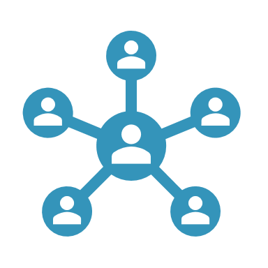








Challenge P14 Measure Link
Gathering data about level of link can be challenging for Community boosters. Here is a short list of usual difficulties :
Declarative bias
Difficulty to frame questions and measurement procedure about link
Difficulty to get the information frequently from all members
Difficulty to gather and interpret weak signals
Unclear legal or ethical limits of Privacy
Depending on what tools are available for Community Boosters, measuring link with real data can become a major challenge. Here are some examples of ways and indicators on link measurement :
Social network platform: Number of “connections” within the Community per member
Chat tools : Frequency of discussion, Diversity and average involvement of chatters, “Depth” of discussions
Event management tools : Number of times an average member meets the same people in event
Polls : Answers on various questions about links
“Feeling” and interpretation by Community Boosters or by Key members of the Community

Slide 11
Exercise P14 Define how you will measure Link
We will measure link in our community with the following indicators …

Slide 12
Share your opinions and experiences
Do you measure link in your Community ? How ?
What are your difficulties ? What indicators have you used ?
Notes:
Answer :

Slide 13

Example story
We have more and more people, which is good. We look like we have more capacity, but people don’t get as much involved as before.

Slide 14



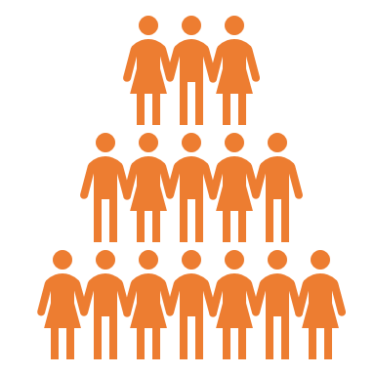
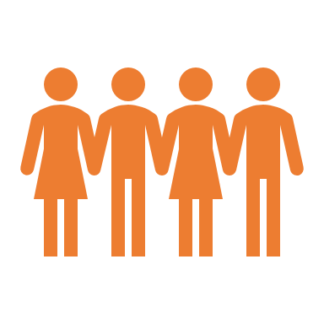

Challenge P15 Understand how link, Numbers and Engagement work together (or not !)
The lower the number of members in a Community, the higher the chances for members to be linked to each other through accumulated direct interactions.
The higher the number, the lower the “average link to members” (if not compensated).
This variation can cause various damageable effects or increase existing effects like Ringelmann effect (decrease of engagement relatively to group size), or like loss of sense of Belonging.
Engagement level can also sometimes increase with additional members, as more members can increase trust, and unlocks more economies of scale and therefore to more potential of actions.
Reading more :
https://en.wikipedia.org/wiki/Dunbar%27s_number
https://en.wikipedia.org/wiki/Ringelmann_effect
Average engagement 80%* Max engagement
Average engagement 100%* Max engagement
Average engagement 40%* Max engagement
Average engagement 60%* Max engagement
*Example numbers to represent Ringelmann effect, not actual numbers ! (will depend on context)
Every level of critical mass unlocks new opportunities thanks to economies of scales

Slide 15
Share your opinions and experiences
Did you witness your Community grow in Numbers ?
Have you observed any effects on engagement when it grew in numbers ?
What strategies have you developed to compensate negative effects, or to amplify positive effects of growing on engagement ?
Notes:
Answer :

Slide 16

Example story
The Community used to feel like a family, now it became unpersonal.
On top of that, some of my friends have left. I don’t know anybody now, and I am less motivated than before.

Slide 17






Challenge P16 Build Link through common identity
As number of members increases, feeling of closeness and link can decrease.
To decrease the time for two members to feel related to each other, Community Boosters can choose to build a common culture, which facilitates interaction by creating references and trust.
This Community identity can be anchored in Artifacts.
Community Booster must balance the cost of learning the culture (which increases the entry and onboarding cost to the Community), the interest of setting up culture for engagement.
Community Boosters must also decide about the organic generation of culture (fostering, directing, slowing it).
https://en.wikipedia.org/wiki/Sapiens:_A_Brief_History_of_Humankind
Example of Community artifacts :
Community Manifesto
Community Charter
Name of the Community & Common name for Community Members
Community values
Community Mascot or fictional characters representing community identity
Community common story telling

Slide 18
Share your opinions and experiences
What are your Community Artifacts ?
In which order have you defined them ?
How does it help your members ? How does it hinder new entrants ?
Notes:
Answer :

Slide 19
Exercise P16 Choose your artefacts and display them on a timeline
WHAT :
We will define / co-create the following artifacts
Example : Community Charter
WHEN:
These artifact will be used when…
Example :
When we reach 50

Slide 20
Example Stories
All Community links depend on me, I’m the only one keeping people together.

Slide 21




Challenge P17 Identify patterns in your Link architecture
Example patterns
Core & Followers pattern: Most members are not linked to each other; a very small core of the community is followed by a throng of followers. This pattern is closer to Fan Communities of Content providers (Youtubers, Streamers, Influencers…).
Pyramid pattern : Members are linked only to a small group of other members, among which a local group leader, who is in turn linked to other group leaders in another small group, etc. This pattern is closer to some large companies, providing strong local link with the cost of broader sense of belonging.
Fabric pattern : Members are all linked to other members in local small groups, but groups are interwoven so that access no member can really prevent access to other members. This pattern is closer to business networks.
Link architecture is an overview of how links are distributed in your Community (between which members).
Link Architectures evolve over time and can be represented with approximate patterns.
Patterns can be used to define a target Link architecture and a link building strategy by Community Boosters

Slide 22
Share your opinions and experiences
What is the current pattern of links in your Community ?
Do you have a target link architecture ? What is it ? Why ?
Notes:
Answer :

Slide 23

Example Story
I must stay connected with too many people at the same time !
I cannot handle it anymore

Slide 24















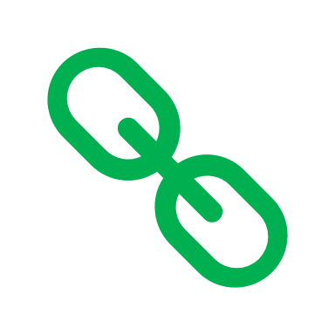
Challenge P18 Limit of links for an individual
Number of links
Any individual has a limited capacity to handle a high number of relationships, no matter how high the limit can specifically be.
When numbers of link exceed key thresholds, which are specific to each person in his/her own context, the general quality of the link decreases.
Depending on the importance of Link in your community, such decrease can be damaging for your Community.
When targeting a specific pattern, or even managing a Community Booster activity, one should consider this effect.
Mistakes, blunder or worse in responses
Only formal moments
Inability to empathize
Link Fatigue
Shorter, less content-rich, less personal responses
Informal moments with shortlist of closest members only
Loss of Empathy and loss of quality of listening
Efforts, but not sustainable on the long run
Respond to messages thoroughly
Informal moments with other members
Careful listening, Empathy
Sustainable effort in relationships

Slide 25
Share your opinions / experiences
Have your ever reached your own limits of link ?
What happened ? How did you manage the situation ?
Mistakes, blunder or worse in responses
Only formal moments
Inability to empathize
Link Fatigue
Shorter, less content-rich, less personal responses
Informal moments with shortlist of closest members only
Loss of Empathy and loss of quality of listening
Efforts, but not sustainable on the long run
Respond to messages thoroughly
Informal moments with other members
Careful listening, Empathy
Sustainable effort in relationships

Slide 26
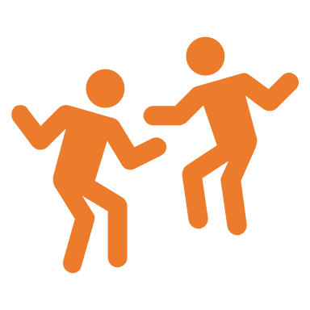

Example Story
It is simple, togetherness goes up at every yearly celebration and goes down in between !

Slide 27






Challenge P19 Identify link dynamics
Links in your Community depends on many factors, not only Community Boosters targets. Link building strategies must include various forces that influence the link dynamics, among which :
External recurring events : National Holidays, Festivals
Internal recurring events : Community Birthday, Community ritual
External spot (happening once) events : Competition, call for help, people leaving and entering the corporation …
Internal spot (happening once) events : Celebrations, Conflicts, …
Link culture : average tendency to link to other members, acceptance of link among peers
Key members activities : Parties, clubs, …
Challenge of Community Boosters is to consider these internal and external forces when deciding the next course of action and designing next events.
It is up the Corporate Community Boosters to identify opportunities for link building and threats of link collapsing.

Slide 28
Share your opinions and experiences
On top of your strategy and Community Boosting actions, what factors influenced the Links in your Community ?
How did you adjust your strategy to these factors ?
External recurring events
Internal recurring events
External spot (happening once) events
Internal spot (happening once) events
Link culture
Key members activities
Notes:
Answer :

Slide 29






Exercise P19 Identify elements that will influence Link in your Community Identify how you will exploit or compensate them
WHAT will increase Link no matter what we do as Community Boosters
Example : Christmas holidays
Example : Organize a Christmas party
HOW we can exploit this positive influence
HOW we can compensate the negative influence
Example : Mix teams from the two conflictual managers
WHAT will decrease Link no matter what we do as Community Boosters
Example :
Recent Conflict between managers

Slide 30

Use case / Example Story
Now all the power is mine !!!

Slide 31





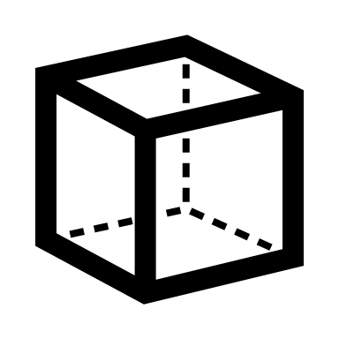
Challenge P20 Embrace Community Booster Ethics
With massive and growing power over attention, content, value, engagement and link, comes related responsibilities. Community Boosting ethics can involve many personal and collective topics, including :
Privacy Concerns
Conflicts of interests
Boundaries between personal and professional links
Free-will vs engagement mechanics
Group thinking
Exclusion effects due a to strong Community identity
These questions should be studied and considered by Community Boosters, from trainees to experts

Slide 32
Share your opinions and experiences
As a Corporate Community Booster, What ethical topics are the most important to you ?
What actions do you do at your level about these topics ?

Slide 33
Exercise P20 Identify ethical questions and propose answers
Ethical question
Example : How will we manage privacy ?
Example :
Idea : allow all users to delete their account, remind them
Example :
Use nicknames instead of real names
Solution

